Slide 1
IBM Hackathon 2018
Presentation
Team Name: ProCoders
Topic Name: Help me with my mood with SHADE (Social media health analysis and display engine)
Team: ProCoders
Topic: Help me with my mood with SHADE (Social media health analysis and display engine)

Slide 2
Team Members & Dedicated Roles:

Slide 3
Divyanshu Gaur – Lead Programmer
Gaurav Goswami – UI/UX Designer & Programmer
Eshani Agarwal – Documentation Writer & Leader
Enosh Kumar – Tester & Mentor

Slide 4
Flow of Control & Data

Slide 5










= → Data
= → Control
1. Access Request
3. Selected Updates
2. Timeline Access
4. Mood/Tone Analysis
5. Tones/Moods

Slide 6
Prominent Tone Detection Algorithm

Slide 7

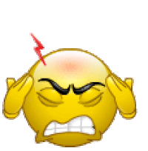




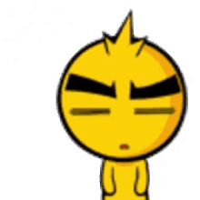
Anger
Confident
Tentative
Sad
Joy
Fear
Analytical

Slide 8
Positive Tones
Analytical
Tentative
Joy
Negative Tones
Anger
Sad
Fear
Confident
Meant to be maintained
Meant to be soothed

Slide 9
if neagativeTone.isPresent()
{
soothe (max (negativeTones.getScore) );
}
else
{
maintain (max (positiveTones.getScore) );
}

Slide 10
Final Approach

Slide 11


= → Data
= → Control
7. Tone Soothing/Maintenance
6. Prominent Tone Detection
1. Access Request
3. Selected Updates
2. Timeline Access
4. Mood/Tone Analysis
5. Tones/Moods

Slide 12
Project at a Glance

Slide 13
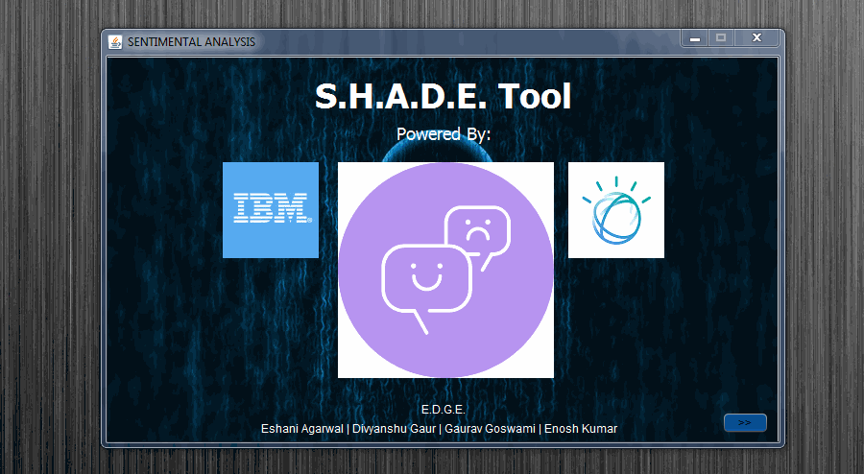
Login Page: This page allows user to login into his/her twitter developer account by OAuth keys.

Slide 14
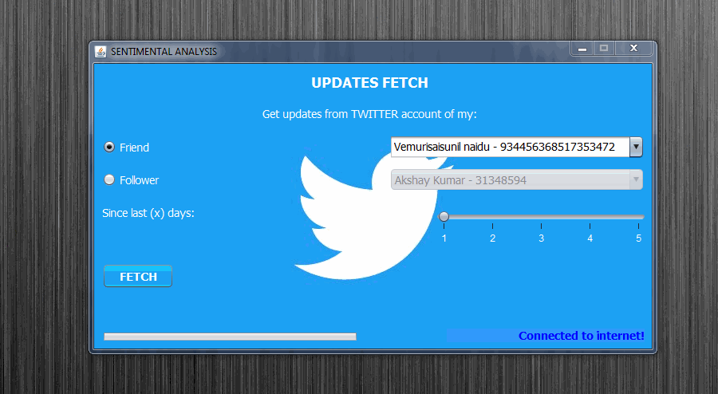
Updates Fetch: This page allows user to select among his/her friends/followers and fetch their recent public updates.

Slide 15
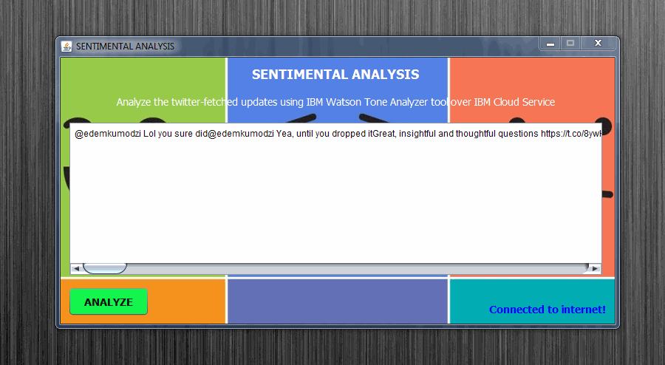
Analysis Page: This page allows user to view fetched updates and then analyze them by using IBM Watson Tone Analyzer.

Slide 16
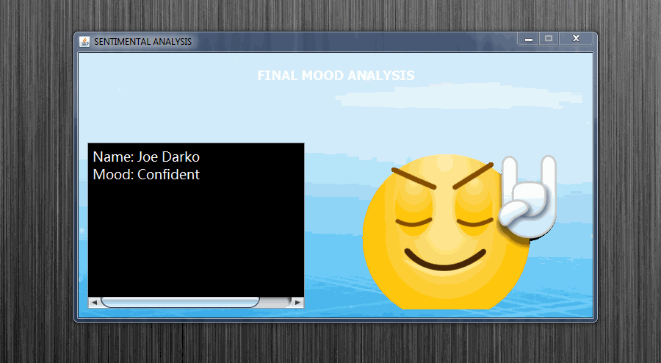
Display Page: This page displays the detected prominent tone and name of the analyzed person.

Slide 17
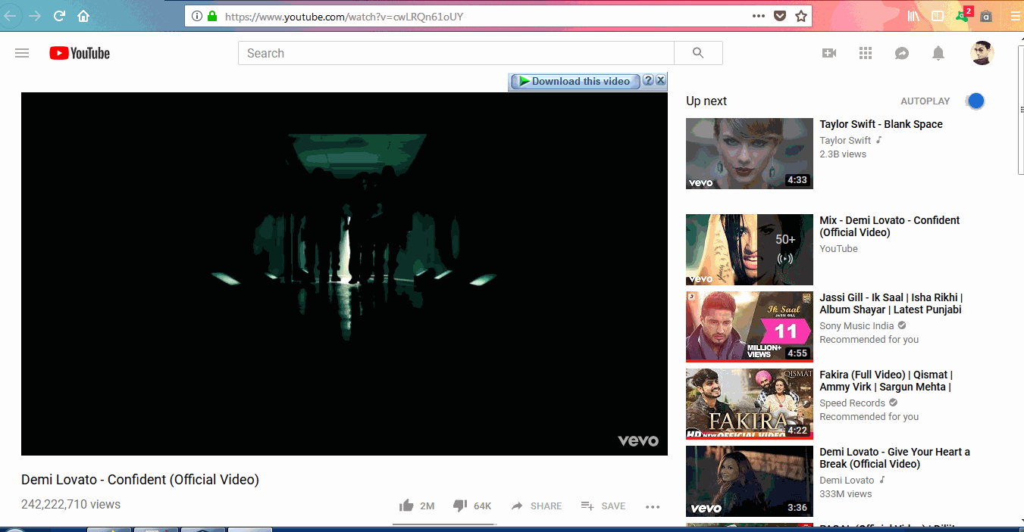
YouTube Page: After Display page, user is redirected to YouTube curated playlists decided according to analyzed person’s prominent mood

Slide 18
TECHNIQUES/PLATFORMS/API’S USED:

Slide 19
Technologies:
Java SE + Java EE
Libraries:
GSON
OkHttp
Jersey
SwingX
Twitter4j
Platforms:
IBM Cloud

Slide 20
THANK YOU ☺

